Slide 1




Mental Health Fitness
Tracker
The Path to Mental Fitness with AI

Slide 2


Ditya Chawla
Name: Ditya Chawla
SkillsBuild Email Id: dityachawla@gmail.com
College Name: Manipal Institute of Technology, Manipal
College State: Karnataka
Internship Domain: Artificial Intelligence(AI)
Start date: 12/06/2023
End Date: 24/07/23

Slide 3




Problem Statement
Mental Health Monitoring: The Mental Fitness Tracker aims to address the growing concern of mental health issues by providing individuals with a tool to monitor and assess their mental well-being regularly.
1
Predictive Mental Fitness: The project focuses on developing a predictive model that estimates an individual's mental fitness based on various mental health indicators, such as anxiety, depression, and substance usage.
2
Personalized Mental Fitness Monitoring with Interactive Visualization: The project aims to predict an individual's mental fitness, offer personalized insights, and empower users to proactively improve their mental well-being through interactive data visualization.
3

Slide 4
01 | Introduction and Student Details
02 | Problem Statement
03 | Project Overview
04 | Target Audience and end Users
05 | Our Solution and Value Proposition
06 | Customization and Innovation
07 | Modelling Techniques
08 | Results and Outcomes
09 | Link to resources
Agenda

Slide 5


The project aims to develop a machine learning-based Mental Fitness Tracker that predicts an individual's mental fitness score based on various mental health indicators.
The purpose of this project is to provide users with insights into their mental health and offer personalized recommendations for mental well-being.
The scope includes data preprocessing, model building, and an interactive user interface.
How to maintain positive mental health
When to seek professional help
Project Overview

Slide 6



Who are the end users?
Global Mental Fitness Monitoring:
Individuals Seeking Self-awareness
Mental Health Professionals & Policymakers
The Mental Fitness Tracker caters to a wide range of users, including individuals, mental health professionals, and policymakers interested in monitoring mental fitness trends across different countries.
Students, working professionals, and anyone interested in their mental well-being can benefit from personalized insights and proactive measures to improve their mental fitness.
Mental health experts and policymakers can utilize the platform to gain valuable insights into mental health trends globally and make informed decisions for mental health interventions and policies.

Slide 7
Your Solution
Our solution, the Mental Fitness Tracker, employs machine learning algorithms to predict mental fitness scores based on user inputs.
Our solution, the Mental Fitness Tracker, employs machine learning algorithms to predict mental fitness scores based on user inputs.
Our innovative solution, the Mental Fitness Tracker, incorporates interactive widgets that allow users to input their mental health information easily.

Slide 8



How did you customize the project?
I customized the Mental Fitness Tracker by creating an engaging and user-friendly interface using interactive widgets (e.g., sliders, drofor data input.
The addition of personalized feedback makes my project stand out, providing users with individualized insights and recommendations.
The unique feature of comparing the user's mental fitness trend with the global average sets our project apart and offers a holistic view of mental well-being.

Slide 9



Modelling
I utilized a Random Forest Regressor to build the predictive model for mental fitness. | Data preprocessing involved handling missing values, feature encoding, and scaling. | Cross-validation was applied to ensure robust model performance.

Slide 10
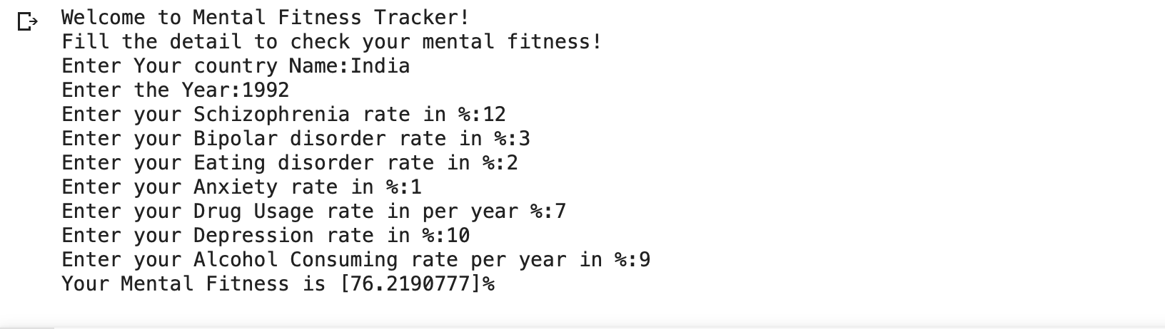
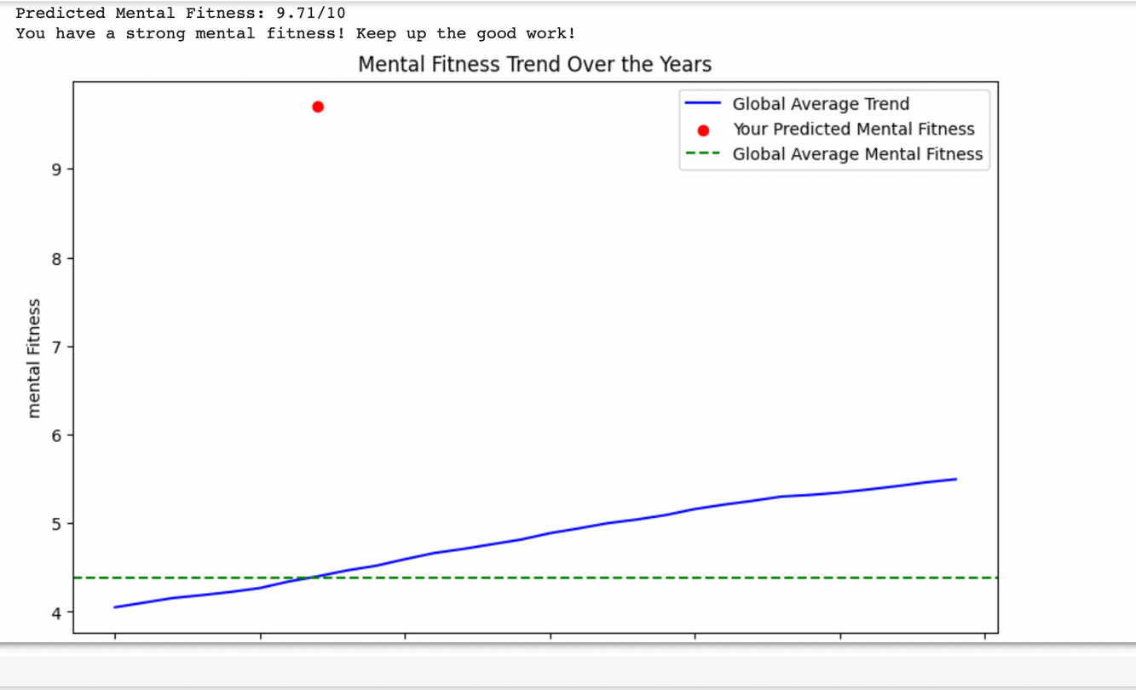
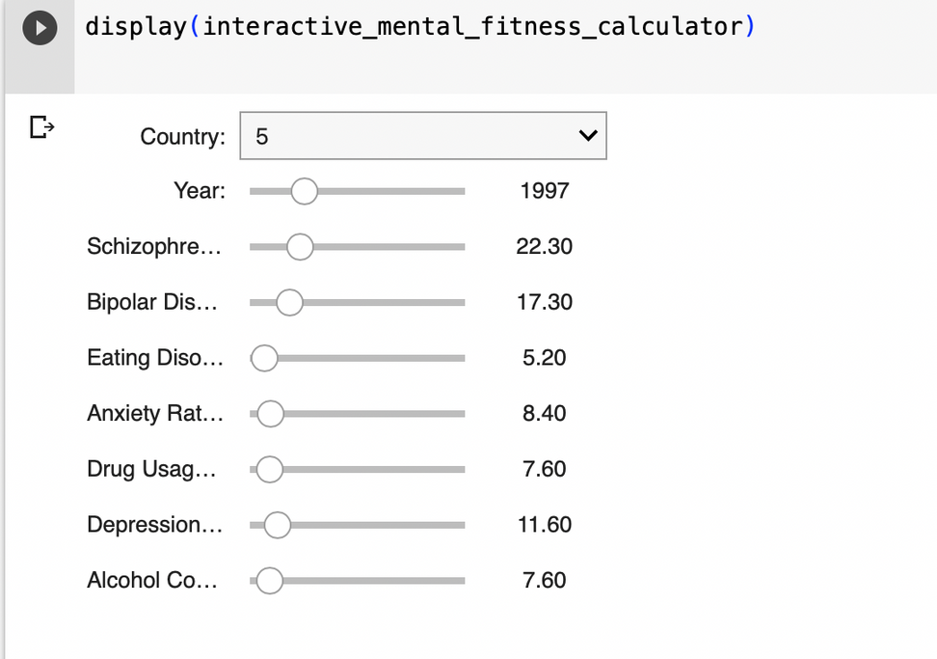
Results

Slide 11


















Resource
Page
Github Repository Link:
https://github.com/DityaChawla/IBM_Mental-Fitness-Tracker

Slide 12




Thank you!

